Slide 1
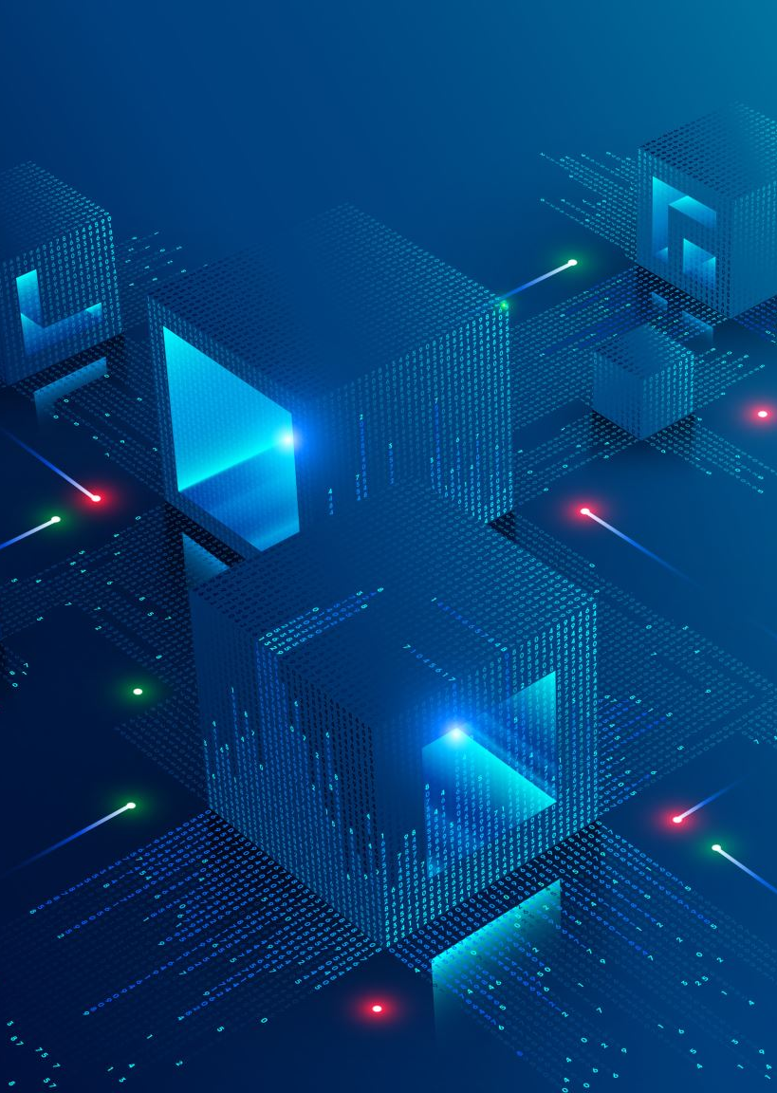
Development of an automated task sequencing framework
Semester Project
Ghazi Cherif

Slide 3
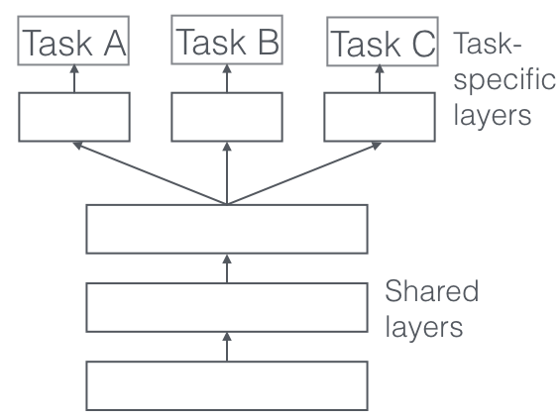
Multitask learning

Slide 4
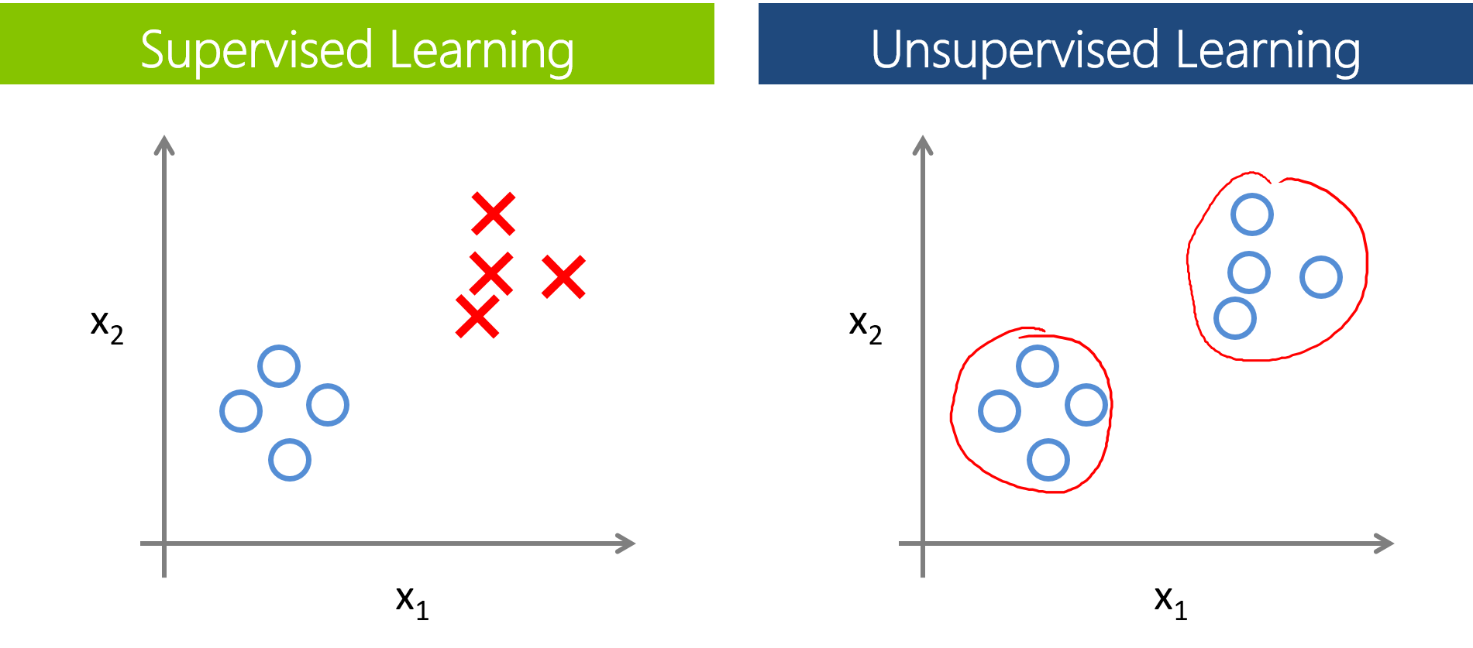
Supervised Vs unsupervised LEarning

Slide 5
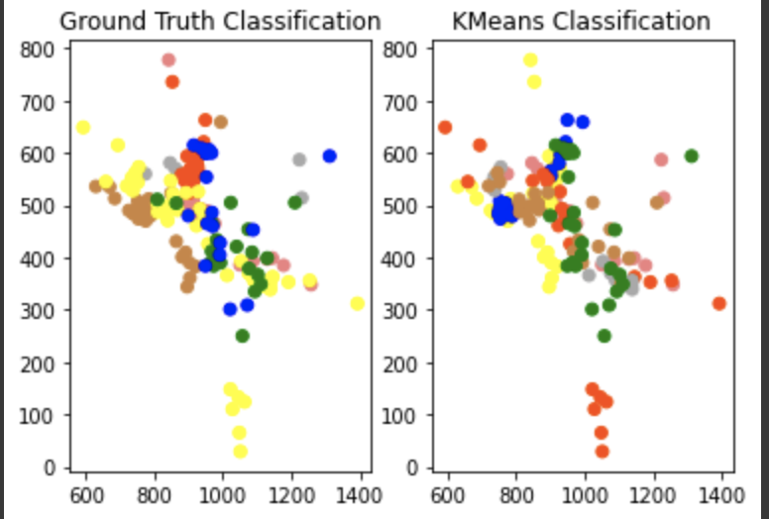
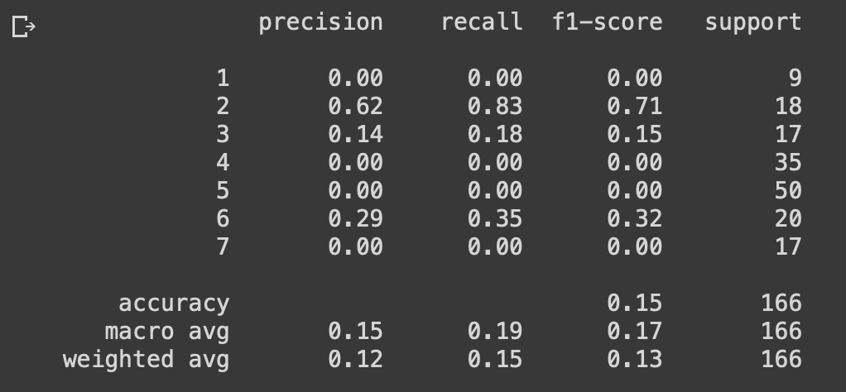
First REsults

Slide 6
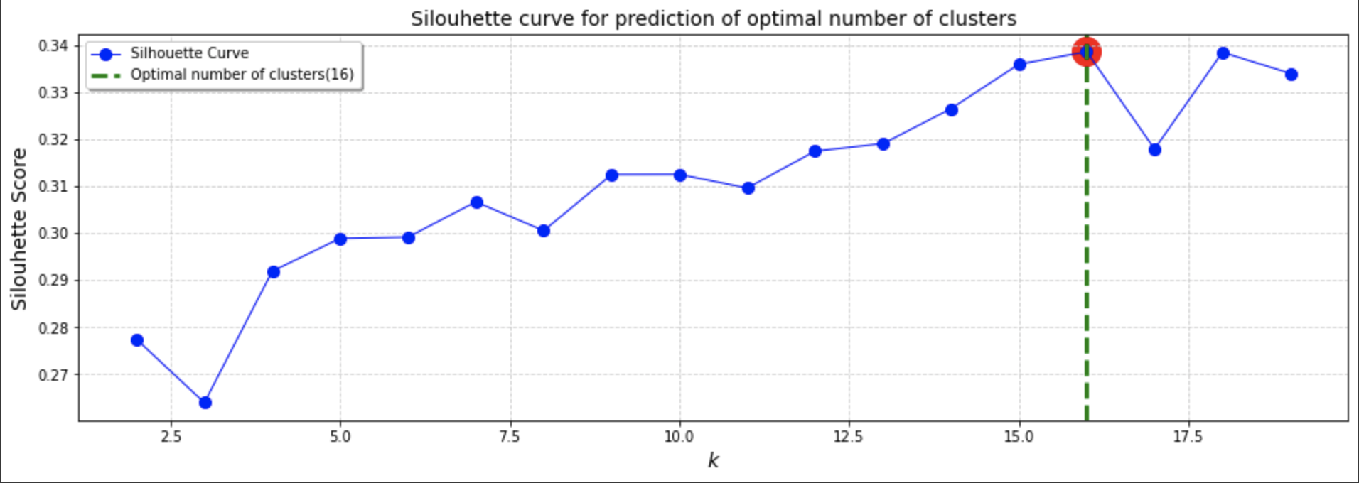
Silhouettes coefficients

Slide 7
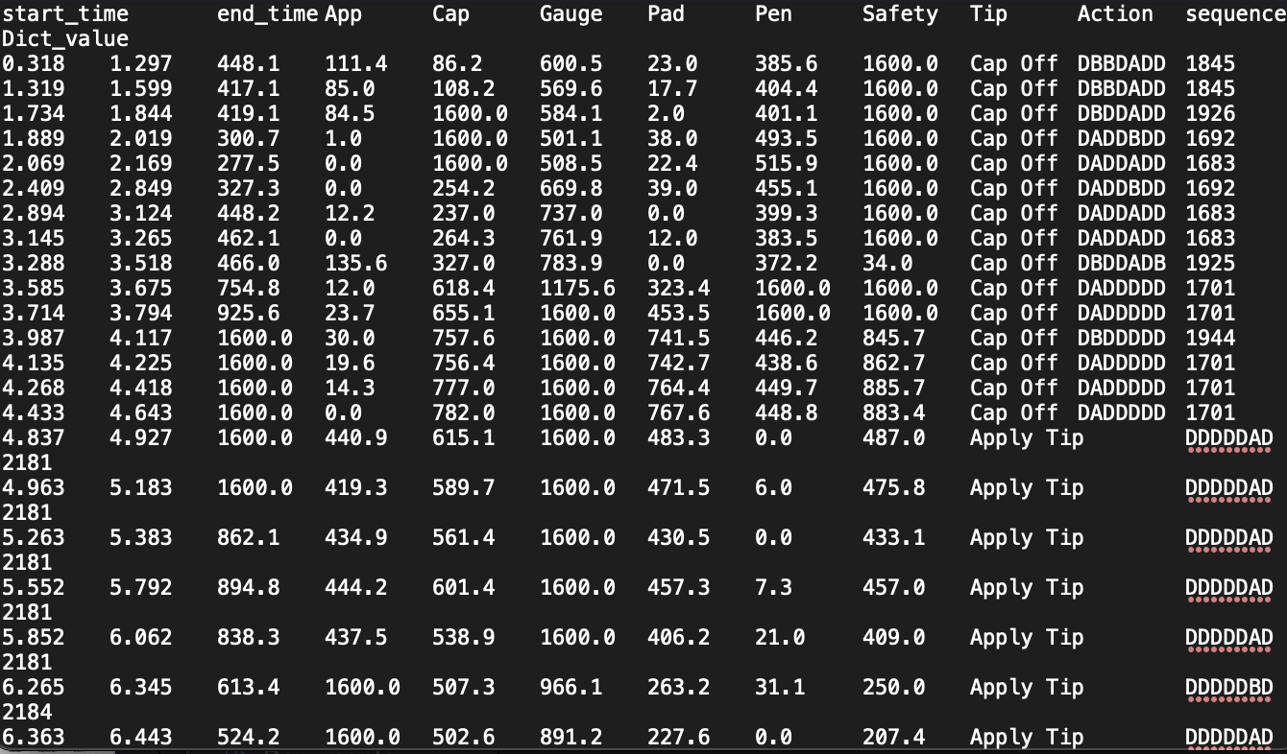
Example data

Slide 8
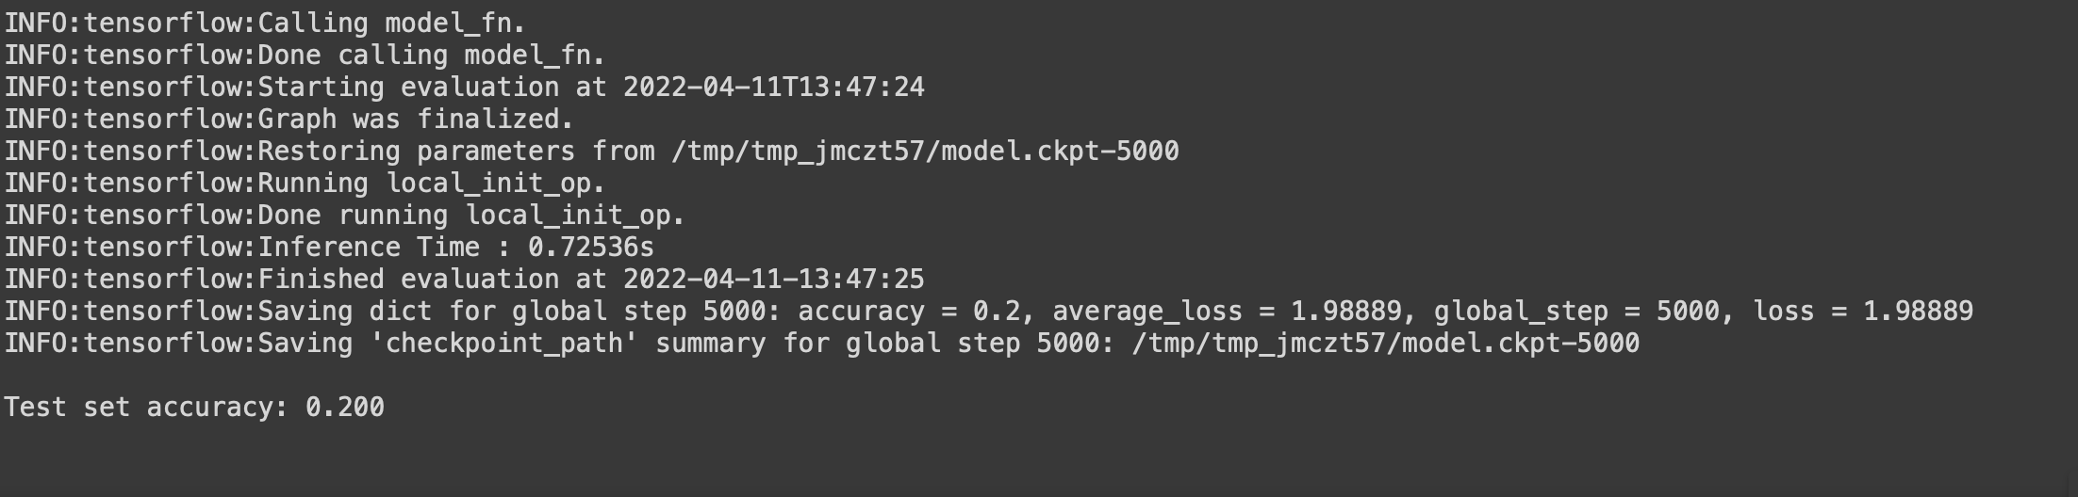
First results

Slide 9
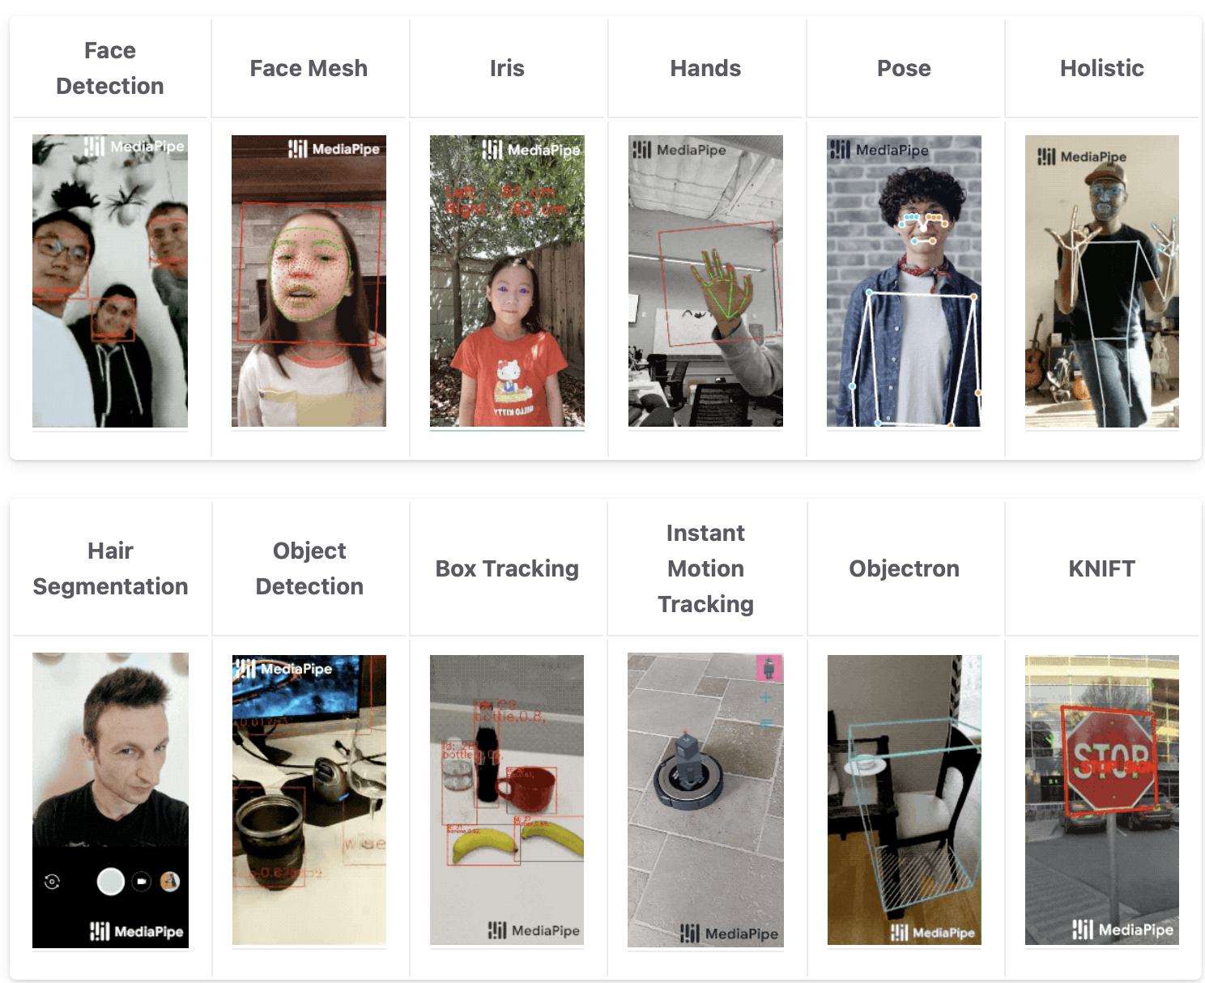
Mediapipe

Slide 10
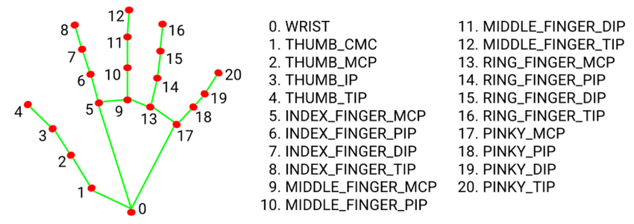
Hand tracking

Slide 11

What we can currently do

Slide 12
Bibliography
https://ruder.io/multi-task/index.html#fn3
https://lakshaysuri.wordpress.com/2017/03/19/machine-learning-supervised-vs-unsupervised-learning/
https://fr.wikipedia.org/wiki/Silhouette_(clustering)
https://google.github.io/mediapipe/

